Slide 1
HIGH CLOUD AIRLNES ANALYSIS
PRESENTED BY:
Nisha P V

Slide 2

CONTENTS
Project Overview
KPI - Insights & Analysis
Data Model Challenges
Conclusion

Slide 3

Project Overview

Slide 4
The High Clouds Project aims to analyze a comprehensive set of operational performance indicators (KPIs) within the U.S. commercial aviation sector. The study leverages real-world data to identify patterns in airline efficiency, passenger transport trends, and route optimization to stay competitive in a dynamic and challenging business environment. It helps airlines navigate operational complexities, mitigate risks and enhance overall performance.
Project Goals:
To identify trends in airline operations from 2008 to 2013.
To support data-driven decision-making for scheduling, fleet planning, and resource allocation.
To explore how passenger behavior and route demands influence performance metrics.
To use KPI insights to help airlines identify areas where improvements can be made in operations.

Slide 5




Analytical Tools Used:
Tools Used: MS Excel, MySQL, Power BI, Tableau

Slide 6
KPI - Insights & Analysis

Slide 7
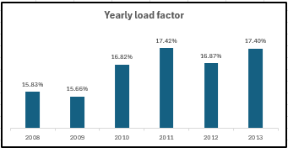
Load Factor by Year
Airlines use load factor for strategic planning, route optimization and fleet management. Load factor is a key metric used for benchmarking an airlines performance against competitors.
As per the analysis 2011 and 2013 have the highest load factors of 17.4% and 2009 has the lowest load factor of 15.66% which shows gradual improvement in average load factor from 2008 to 2013.

Slide 8
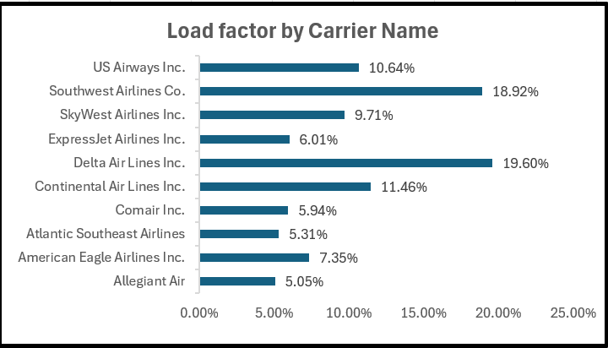
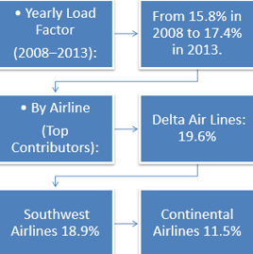
Load Factor by Carrier Name
Delta Airlines has the highest load factor of 19.6% with 28837271 transported passengers.

Slide 9
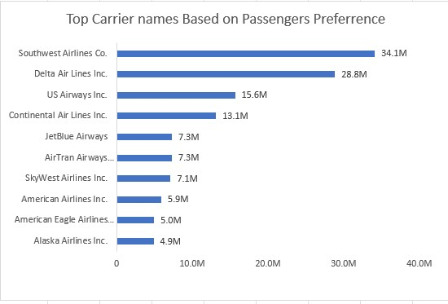
Carrier Names based on Passengers Preference
Southwest Airlines is the most preferred carrier with 34.1 million passengers.
Delta Air Lines follows closely with 28.8 million passengers
Smaller regional airlines like American Eagle and Alaska Airlines have lower passenger numbers, under 5.1 million.
Identifying market leaders in the airline industry.
Understanding customer preference and airline popularity.
Making decisions related to partnerships, advertising, or expansion based on carrier popularity.

Slide 10
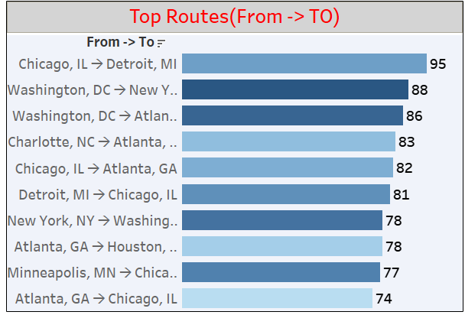
Top Routes based on Number of Flight
The chart illustrates the most frequently traveled flight routes, based on airline ID counts, filtered by Year, Quarter, and Month. The top route is from Chicago, IL to Detroit, MI with 95 recorded flights.
Major hubs like Chicago, Atlanta, and Washington, DC appear multiple times as origin or destination cities, highlighting their importance in the air travel network. This analysis is useful for understanding traffic patterns and optimizing airline operations.
Chicago, IL and Atlanta, GA appear frequently as origin or destination.
Routes between major hubs (e.g., DC ↔ NY, Chicago ↔ Detroit) dominate.
This data helps prioritize high-traffic corridors for operational planning or service improvement.

Slide 11
Weekdays VS Weekends Load Factor
Air Lines
Weekends
Load Factor %
Air Lines
Weekdays
Load Factors %
Weekdays Load Factor Occupied from 2008 to 2013 is 71.18%
Weekends Load Factor Occupied from 2008 to 2013 is 28.82%
Weekday airline load factors are higher than weekend load factor
Based on calculations from 2008 to 2013, the weekday load factor is 71.18%.
Based on calculations from 2008 to 2013, the Weekends load factor is 28.82%.

Slide 12
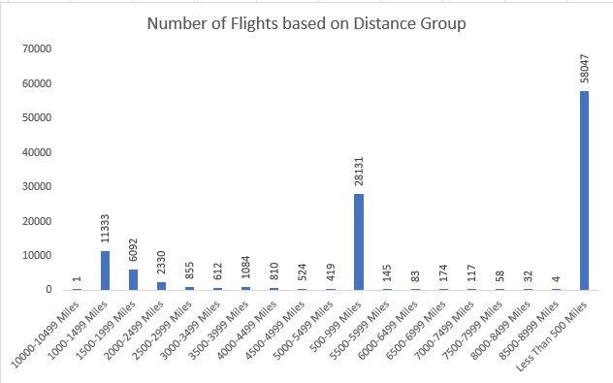
Number of Flights based on Distance Group
Majority of Flights Are Short-Haul:
  The highest number of flights (58,047 flights) are in the “Less Than 500 Miles” category.
  This suggests a strong preference or operational need for short-haul domestic travel.
2. Moderate Traffic in Medium-Haul Range:
  The 500–999 miles group has the second-highest number of flights: 28,131 flights.
  Indicates medium-distance routes are also commonly traveled.

Slide 13
Number of Flights based on Distance Group
3. Sharp Decline in Long-Haul Flights:
  Flights covering distances 1000 miles and above drop significantly in number.
  For example:
    1000–1499 miles: 11,333 flights
    1500–1999 miles: 6,092 flights
    2000–2499 miles: 2,330 flights
  Very few flights are in distance groups 6000+ miles, all below 200 flights
4. Near-Zero Flights in Extreme Ranges:
  Almost no flights in:
    10000–10499 miles: Only 1 flight
    9500–9999 miles: 4 flights
    8500–8999 miles: 32 flights

Slide 14
Data Model Challenges

Slide 15
Data Cleaning & Preparation: The raw data had missing values and date fields split into Year, Month, and Day - we used Power Query to clean and merge them into a usable format.
Data Volume: Managing and processing large datasets efficiently.
Data Quality: Ensuring Accuracy and reliability of the data.
Complex Relationships: Establishing connections between different data points of the data.
Data Merging: For Extracting different KPIs we needed to merge the datasets with the help of power query.
Dashboard Performance: Too many visuals made the dashboard slow - we optimized by showing top airlines only and replaced tables with cards and KPIs.

Slide 16
DASHBOARDS
Data can be complex, but it doesn't have to be overwhelming. That’s where dashboards come in, it provides a clear, concise view of the most critical data. These dashboards offer real-time insights, enabling us to monitor performance, identify trends, and support informed, strategic decision-making.

Slide 17
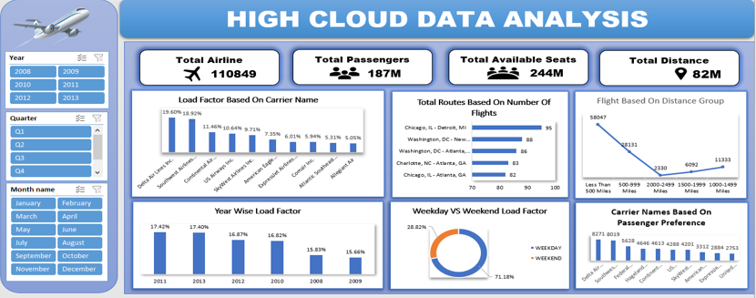
Excel Dashboard

Slide 18
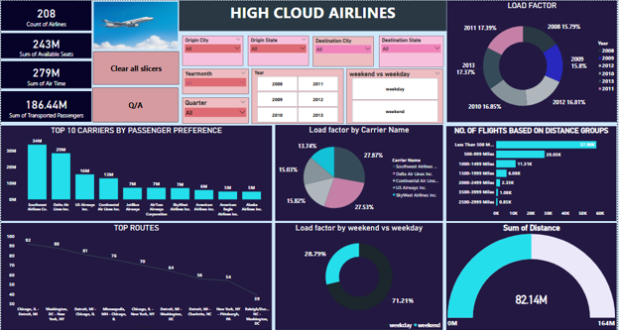
Power BI Dashboard

Slide 19
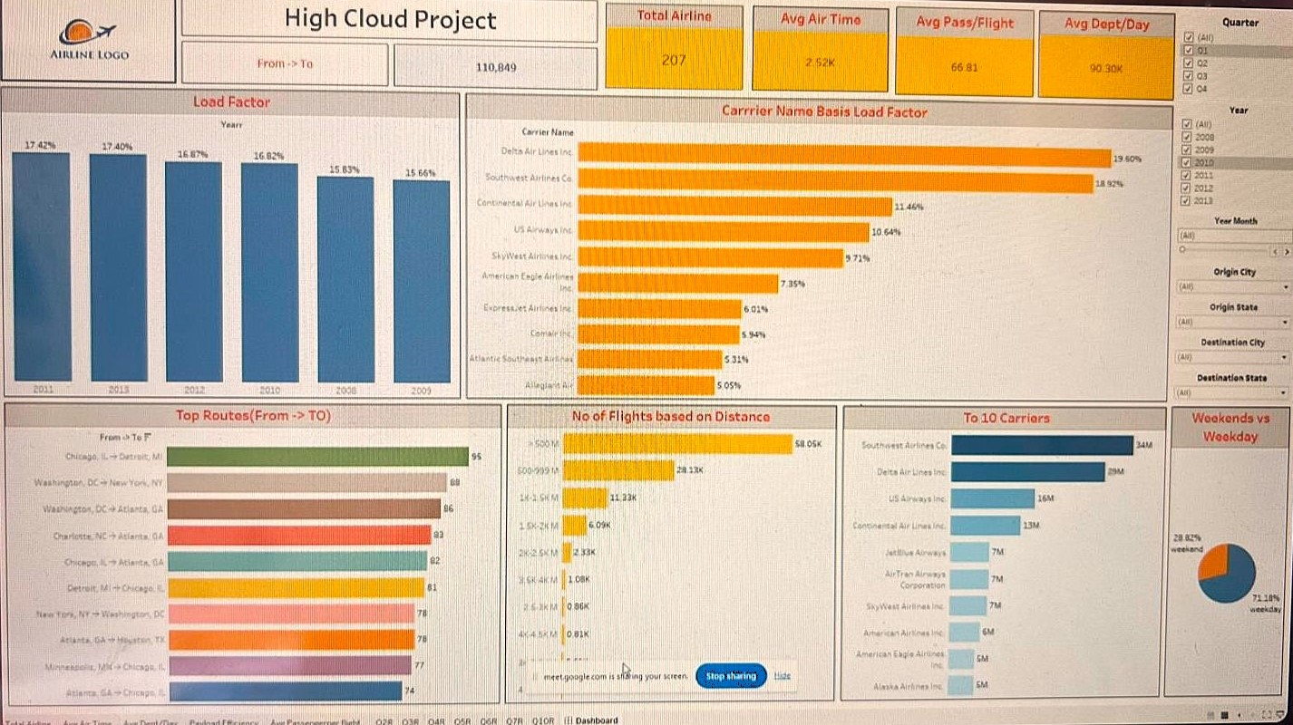
TABLEAU DASHBOARD

Slide 20
Conclusion

Slide 21
High Cloud Airlines empowers the aviation industry with actionable insights, forecasting efficiency and strategic decision making. The presented KPIs offer a glimpse into the vast potential for improvement and growth within the industry. By harnessing the power of data, we can drive positive changes, ensuring a bright future for High Cloud Airlines and its partners in the aviation sector.

Slide 22
Thank You

